Slide 1
VPN: Virtual Private Networks
Presented by:
MICHELLE OPIYO
Transforming education through ICT

Slide 2
INTRODUCTION
What is a VPN?
Transforming education through ICT

Slide 3
Introduction: What is a VPN?
Virtual
Private
Network
Transforming education through ICT

Slide 4
INTRODUCTION TO VPN
A VPN is a private network in the sense that it carries confidential information, protected by various security mechanisms, between known parties.
VPNs are only "virtually" private, because the data actually travels over shared – open to all public internet networks instead of fully dedicated private connections. E.g: private leased line
Transforming education through ICT

Slide 5
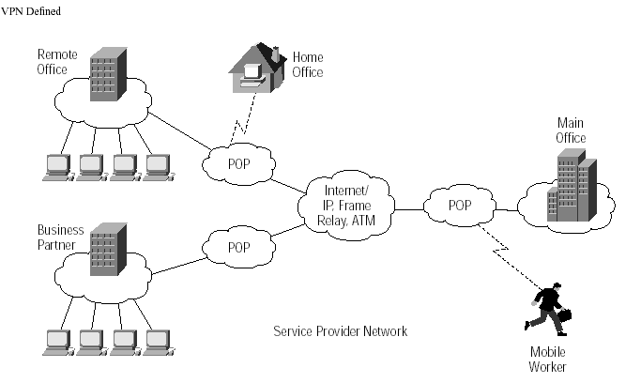
Introduction to VPN
Transforming education through ICT

Slide 6
Closed Private Networks vs. Virtual Private Networks
*Closed Private Networks : - private leased lines, private Intranet links [fiber/copper …]
VPN - The public Internet is used as the backbone for VPNs. This saves costs tremendously from reduction of equipment and maintenance, leased line costs
Transforming education through ICT

Slide 7
VPN TOPOLOGY
How does a VPN work?
Transforming education through ICT

Slide 8
VPN Topology: Types of VPNs
Remote access VPN
Intranet VPN
Extranet VPN
Transforming education through ICT

Slide 9
Remote Access/ Road Warrior VPN – Allows constantly moving employees to securely connect to office. A VPN client is normally required. All user needs is credentials – VPN config “pushed” to user
Intranet – Connects remote branches of the organization to the hub/hq
Extranet – Provide business partners, sub-contractors secure access to critical internal data
Transforming education through ICT

Slide 10
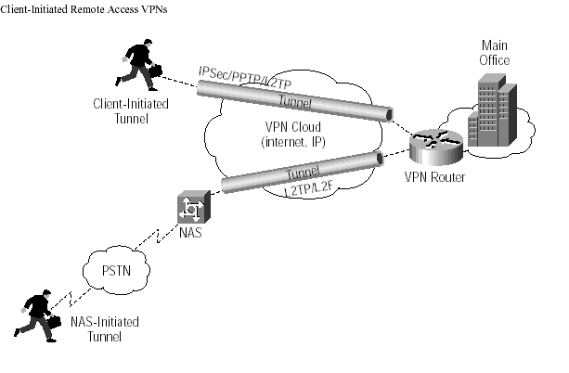
VPN Topology: Remote Access VPN
Transforming education through ICT

Slide 11
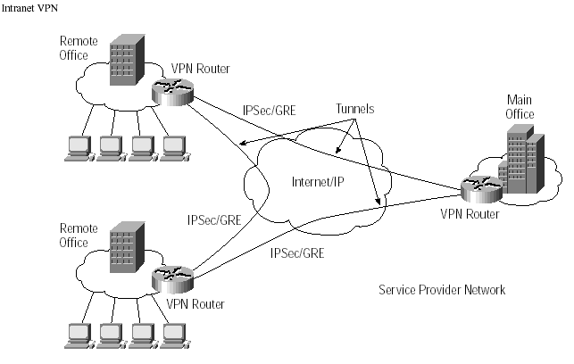
VPN Topology: Intranet VPN
Transforming education through ICT

Slide 12
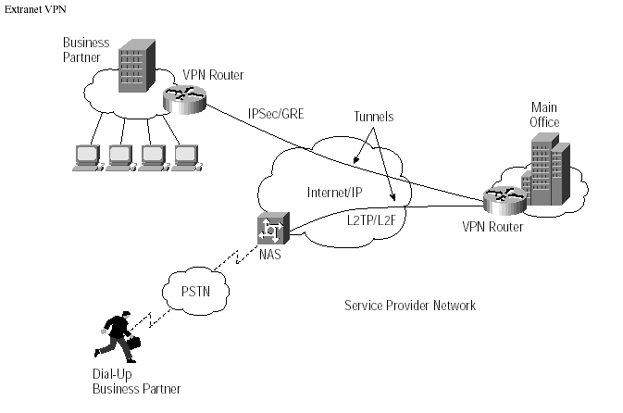
VPN Topology: Extranet VPN
Transforming education through ICT

Slide 13
VPN Topology: Advantages and Disadvantages of VPN
Advantages:
Greater scalability
Easy to add/remove users
Reduced long-distance telecommunications costs
Mobility
Security
Transforming education through ICT

Slide 14
VPN Topology: Advantages and Disadvantages of VPN
Disadvantages
Lack of standards
Understanding of security issues
Unpredictable Internet traffic
Difficult to accommodate products from different vendors
Transforming education through ICT

Slide 15
VPN Topology: What is needed?
Existing hardware (Servers, workstations,…)
Internet connection
VPN - Router/Switch
Software to create and manage tunnels
Security Device such as firewall
Transforming education through ICT

Slide 16
VPN Topology: How it works
Operates at layer 2 or 3 of OSI model
Layer 2 frame – Ethernet
Layer 3 packet – IP
Tunneling
allows senders to encapsulate their data in IP packets that hide the routing and switching infrastructure of the Internet
to ensure data security against unwanted viewers, or hackers.
Transforming education through ICT

Slide 17
VPN COMPONENTS
What are the components of VPN?
Transforming education through ICT

Slide 18
VPN Components
Protocols
Security
Appliances
Transforming education through ICT

Slide 19
VPN Components: Protocols
IP Security (IPSec)
Transport mode
Tunnel mode
Point-to-Point Tunneling Protocol (PPTP)
Voluntary tunneling method
Uses PPP (Point-to-Point Protocol)
Transforming education through ICT

Slide 20
VPN Components: Protocols
IP Security (IPSec)
Transport mode
Tunnel mode
Point-to-Point Tunneling Protocol (PPTP)
Voluntary tunneling method
Uses PPP (Point-to-Point Protocol)
Transforming education through ICT

Slide 21
VPN Components: Protocols
Layer 2 Tunneling Protocol (L2TP)
Exists at the data link layer of OSI
Composed from PPTP and L2F (Layer 2 Forwarding)
Compulsory tunneling method
Transforming education through ICT

Slide 22
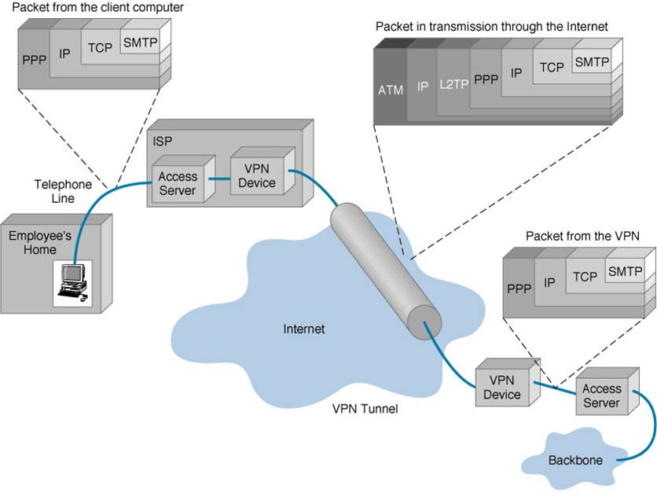
Example of packet encapsulation
Transforming education through ICT

Slide 23
VPN Components: Security
Encryption
Technique for scrambling and unscrambling information
Unscramble – called clear-text
Scrambled information – cipher-text
Transforming education through ICT

Slide 24
VPN Components: Security
Keys
Secret code that the encryption algorithm uses to create a unique version of cipher-text
8-bits keys = 256 combinations or two to the eighth power
16-bits keys = 65,536 combinations or two to the 16th power
56-bits keys = 72,057,594,037,927,900 or two to the 56th power
168-bits keys …
Transforming education through ICT

Slide 25
VPN Components: Security
TYPES OF ENCRYPTIONS
SYMMETRIC ENCRYPTIONS
Sender, receiver share the secret key. In communications with each other the secret key is used to encrypt, decrypt data
Transforming education through ICT

Slide 26
VPN Components: Security
ASSYMETRIC ENCRYPTION
Public Key encryption
Each of the parties involved has crypto two keys. A public key known to all and a private key known only to owner
A wants to communicate with B. A looks up B’s public key and uses it to encrypt data. The encrypted data can only be decrypted using B’s private key
Transforming education through ICT

Slide 27
VPN Components: Security
Digital Signatures:
B wants to communicate with A – needs to confirm A’s id. To authenticate himself, A signs a message using his private key to generate digital signature. B takes encrypted message, A’s public key and runs signature verification to confirm authenticity
Transforming education through ICT

Slide 28
VPN Components: Security
Authentication
Determine if the sender is the authorized person and if the data has been redirect or corrupted
User/System Authentication
Data Authentication
Transforming education through ICT

Slide 29
VPN Components: Appliances
Intrusion detection firewalls
Monitors traffic crossing network parameters and protects enterprises from unauthorized access
Packet-level firewall checks source and destination
Application-level firewall acts as a host computer between the organization’s network and the Internet
Transforming education through ICT

Slide 30
QUALITY OF SERVICE (QoS)
WHAT IS QoS?
Transforming education through ICT

Slide 31
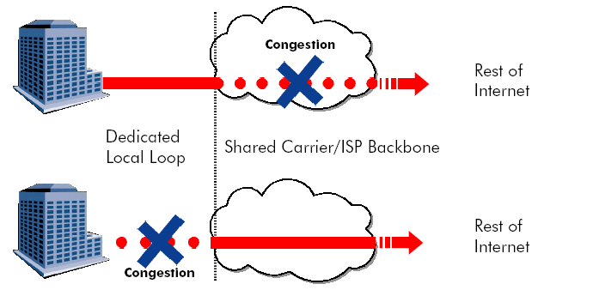
What is QoS?
Transforming education through ICT

Slide 32
VPN Productivity and Cost Benefits: Quality of Service
Question: “Do I get acceptable response times when I access my mission critical applications from a remote office?”
Transforming education through ICT

Slide 33
QoS Options
Two models are available for QoS functionality:
Differentiated Services Model (DiffServ)
Integrated Services Model (IntServ)
Transforming education through ICT

Slide 34
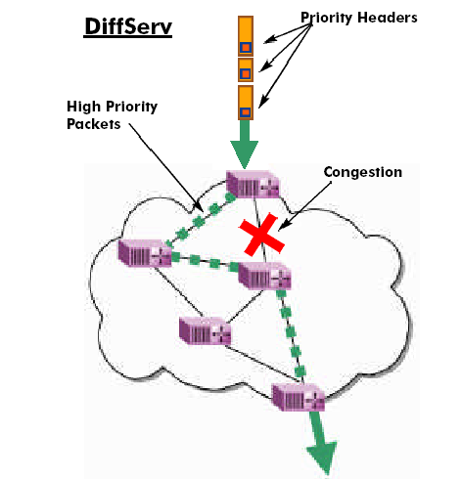
Differentiated Services Model (DiffServ)
Transforming education through ICT

Slide 35
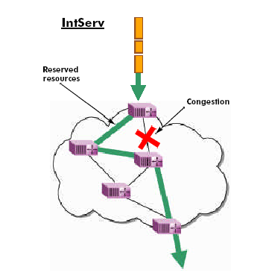
Integrated Services Model (IntServ)
Transforming education through ICT

Slide 36
QUESTIONS?
Transforming education through ICT

Slide 37
Thank You
www.kenet.or.ke
Jomo Kenyatta Memorial
Library, University of Nairobi
P. O Box 30244-00100, Nairobi.
0732 150 500 / 0703 044 500

